Slide 1
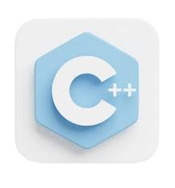
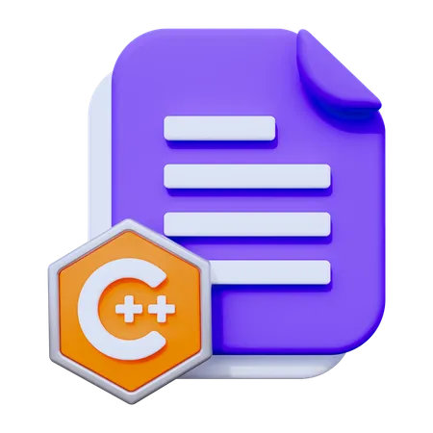
Lecture 1 - Fundamentals
Programming Fundamentals with C++
Dr. Muhammad Sajjad

Slide 2

Overview
Introduction to Programming and Computers
What is Programming?
Basic Computer Science Concepts
Why Learn Programming?
Introduction to C++ Programming Language
History of C++
Why Use C++?
Structure of a C++ Program?
Setting up a Development Environment
Basic Syntax and First Program
Hello, World Program
Explanation of Code Structure
Running and Compiling a Program
Understanding Errors

Slide 3

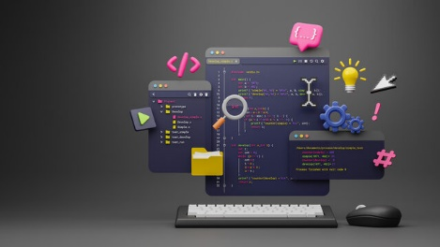
Introduction to Programming and Computers
What is Programming?
Definition: Programming is the process of creating a set of instructions that a computer follows to perform specific tasks. It involves writing code in a programming language, which is a way to communicate with computers.
Why Program?: Programming allows us to automate tasks, solve complex problems, and create applications or software that can be used in various fields—engineering, healthcare, finance, entertainment, and more.

Slide 4
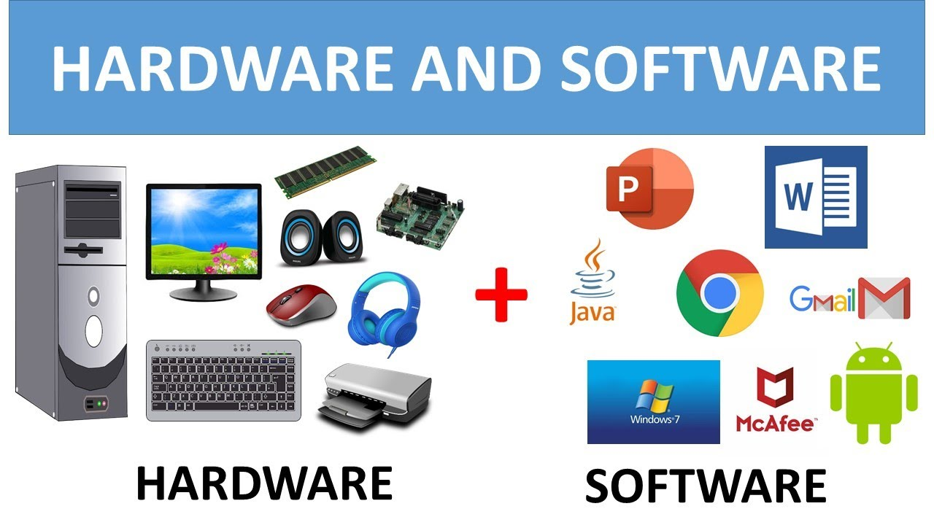
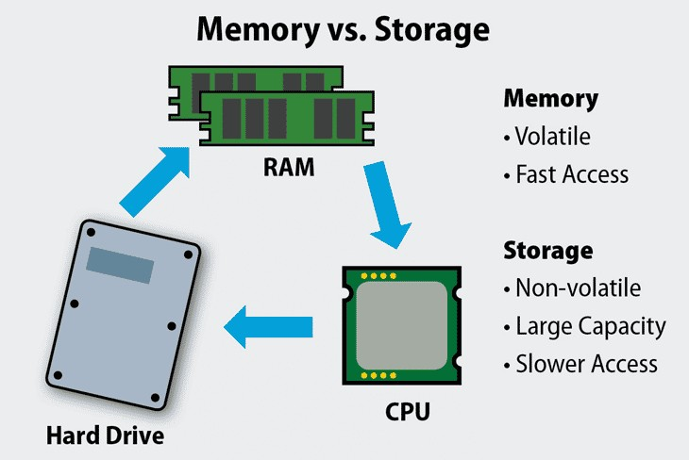
Introduction to Programming and Computers
Basic Computer Science Concepts
Hardware vs. Software:
Hardware refers to the physical components of a computer (e.g., CPU, memory, keyboard).
Software includes programs and applications that run on the hardware, like Windows, games, and text editors.
CPU (Central Processing Unit):
Known as the "brain" of the computer, the CPU executes instructions from programs. It performs calculations and manages data.
Memory (RAM and Storage):
RAM (Random Access Memory): Temporary storage that holds data and instructions while a program is running. It’s fast but erased when the computer is turned off.
Storage (e.g., hard drives, SSDs): Long-term storage for files and applications that persist even when the computer is powered off.

Slide 5



Introduction to Programming and Computers
Creativity and Innovation: Programming is a way to create new tools, applications, and solutions for real-world problems.
Why Learn Programming?
High Demand: Many industries need programmers to develop software, manage data, and automate tasks.
Problem Solving: Programming teaches problem-solving skills, as it involves breaking down complex tasks into smaller steps.
Creativity and Innovation: Programming is a way to create new tools, applications, and solutions for real-world problems.
Applications Across Fields:
Medicine: Automating diagnostics, analyzing medical data.
Engineering: Designing simulations, controlling hardware.
Education: Creating interactive learning platforms.

Slide 6
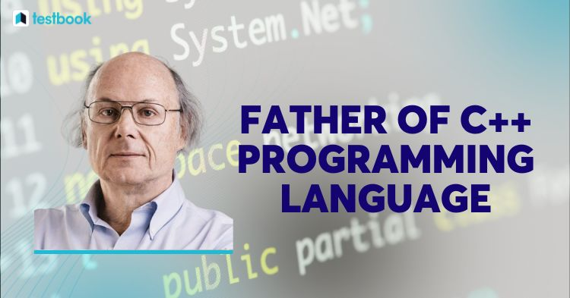
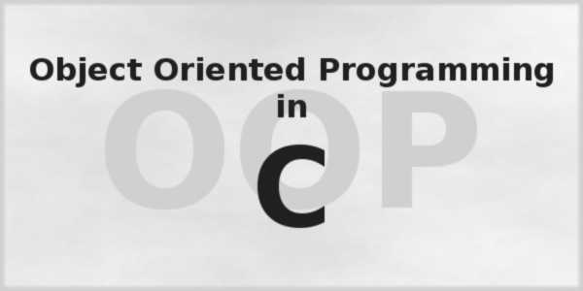
Introduction to C++ Programming Language
History of C++
Origins: C++ was developed by Bjarne Stroustrup in the early 1980s as an extension of the C programming language.
Purpose: C++ was created to add object-oriented features to C, making it more versatile for large, complex programs.
Popularity: It’s widely used in applications that require performance and control, like system software, game development, real-time simulations, and embedded systems.

Slide 7
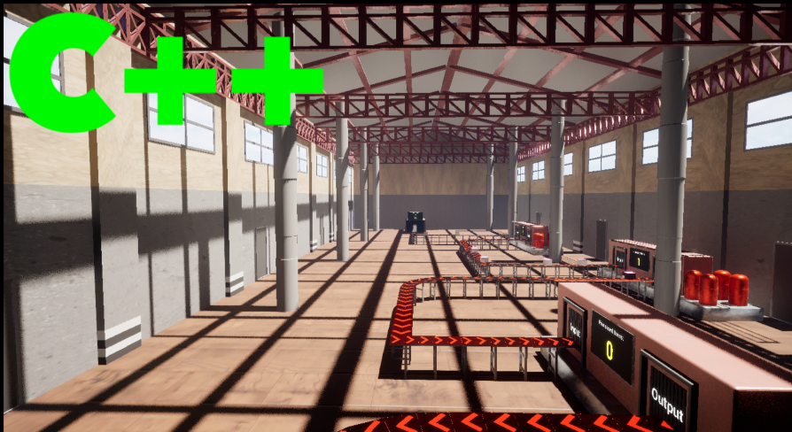
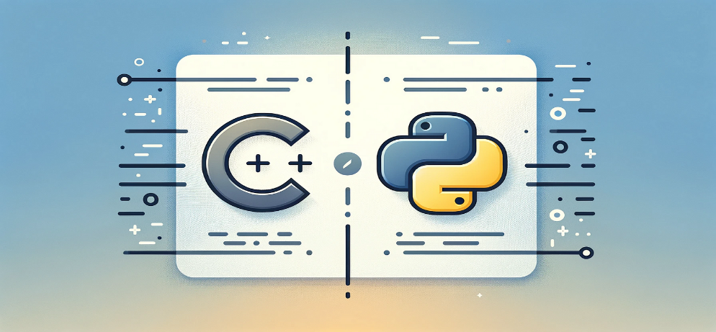
Introduction to C++ Programming Language
Why Use C++?
Performance: C++ is a compiled language, meaning it’s converted directly into machine code that the computer can execute. This makes it fast and efficient.
Flexibility: C++ supports both high-level (object-oriented) and low-level (system programming) features.
Widely Used: C++ is still one of the most popular languages for high-performance applications.
Transferable Skills: Learning C++ provides a strong foundation for other languages, as many concepts (like variables, loops, and functions) are common across programming languages.

Slide 8
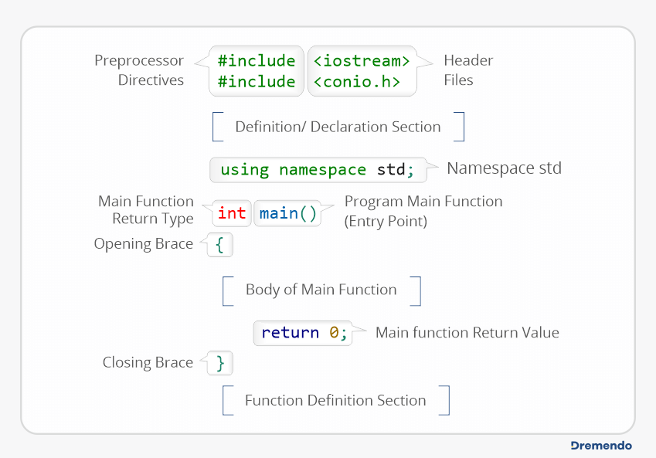
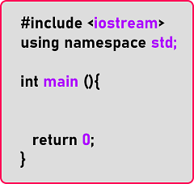
Introduction to C++ Programming Language
Structure of a C++ Program
Headers and Libraries
Main Function
Statements
Return Statement

Slide 9
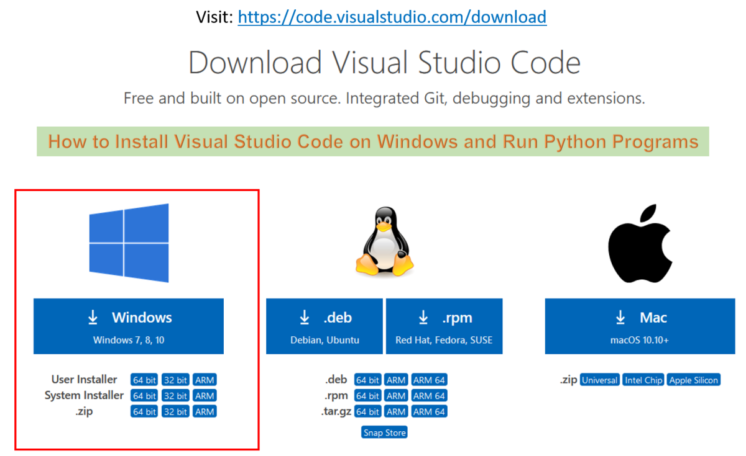
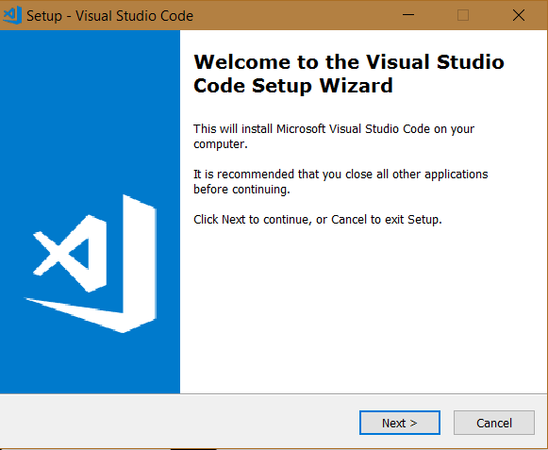
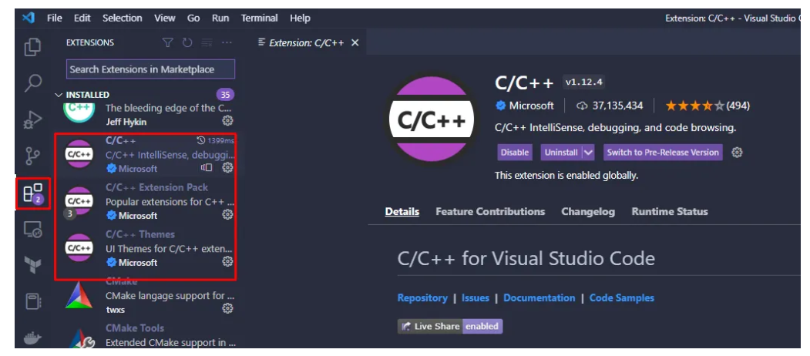
Introduction to C++ Programming Language
Setting up a Development Environment (VS Code)
Install Visual Studio Code (VS Code)
Download and install VS Code from the official website.
Install C/C++ extension in VS Code
Open VS Code.
Go to the Extensions tab (left sidebar) and search for C/C++.
Click Install to add the C/C++ extension.

Slide 10
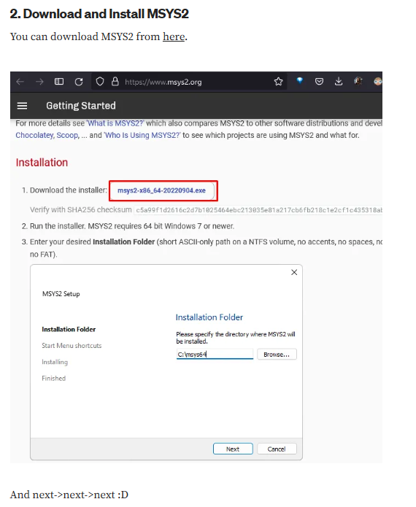
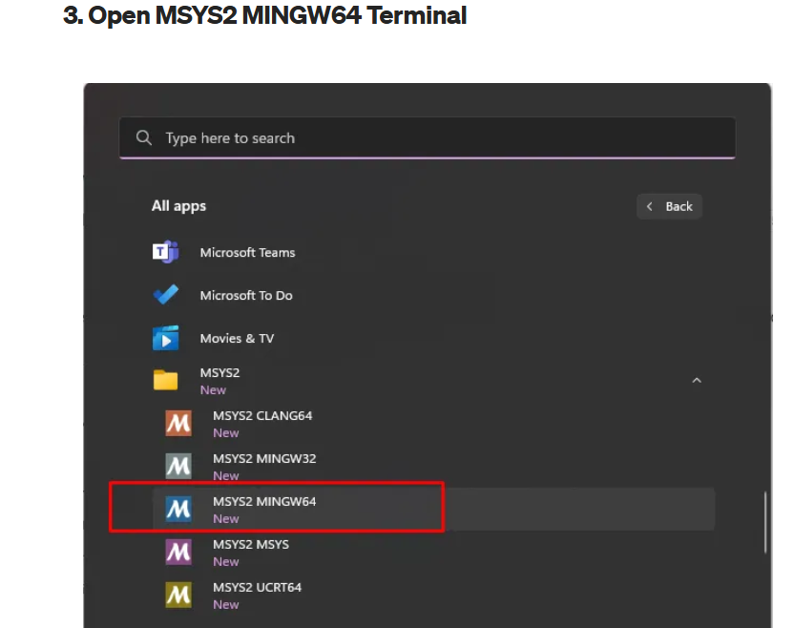
Introduction to C++ Programming Language
Setting up a Development Environment (VS Code)
From here: https://www.msys2.org/

Slide 11
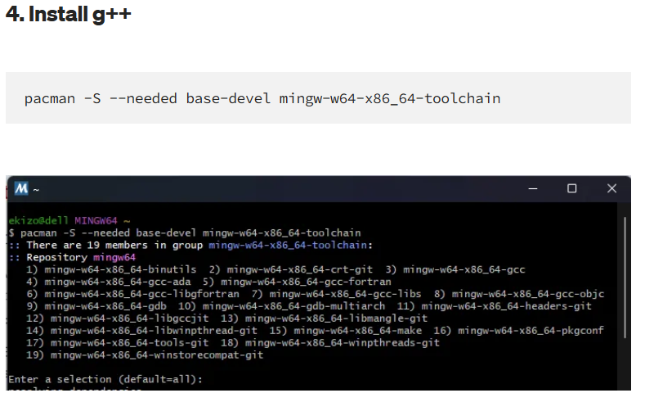
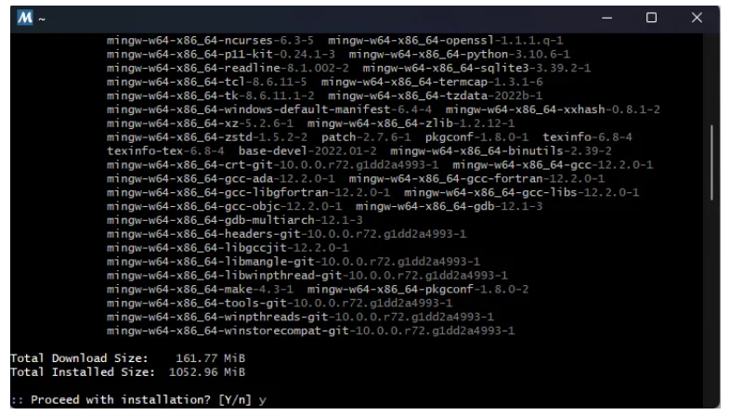
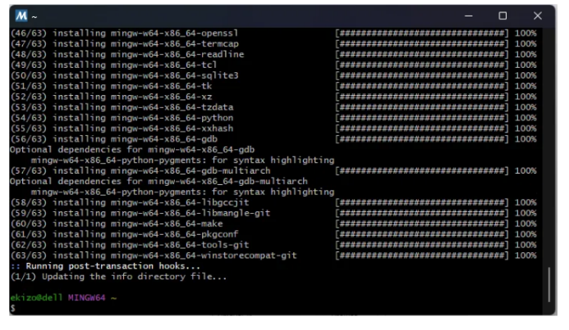
Introduction to C++ Programming Language
Setting up a Development Environment (VS Code)
1. Enter Below Command
3.Press y & Enter
2.Click Enter
4. g++ has been installed

Slide 12
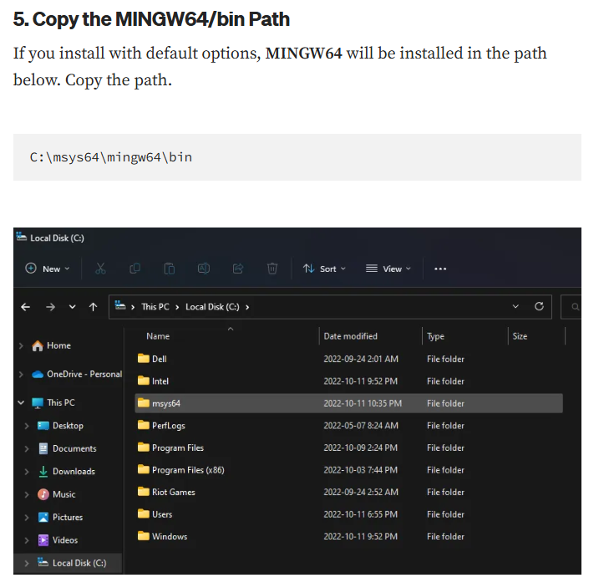
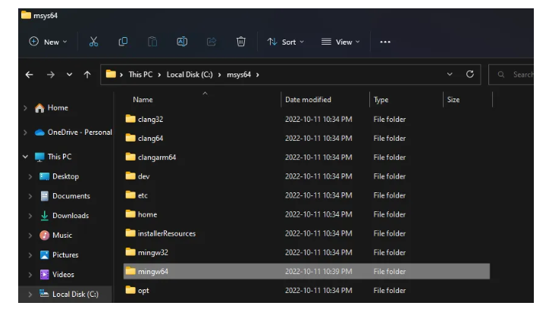
Introduction to C++ Programming Language
Setting up a Development Environment (VS Code)
1.Click here and Ctrl+C
2. Or just copy this path

Slide 13
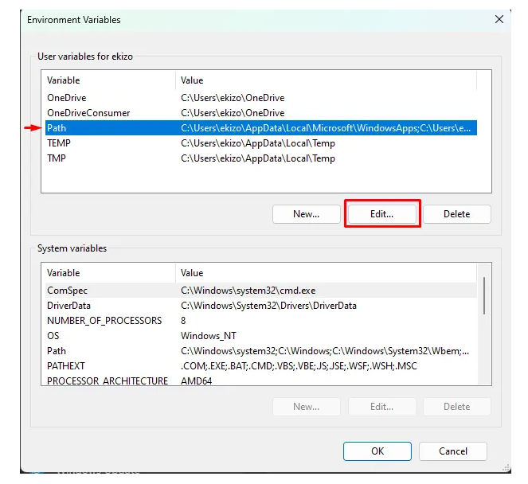
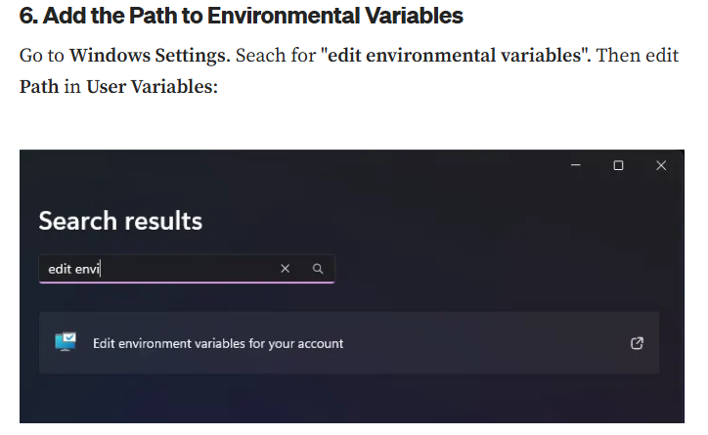
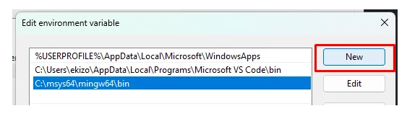
Introduction to C++ Programming Language
Setting up a Development Environment (VS Code)

Slide 14
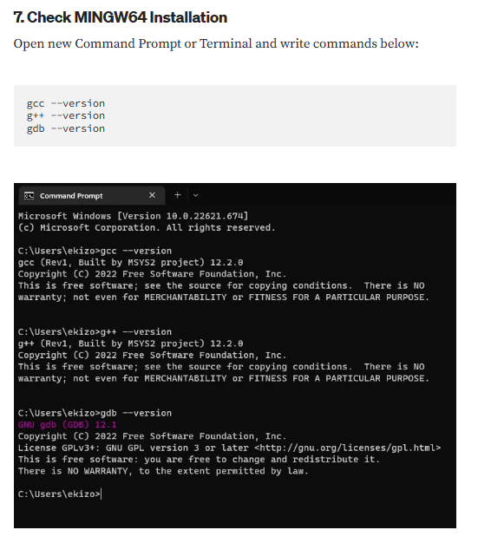
Introduction to C++ Programming Language
Setting up a Development Environment (VS Code)

Slide 15
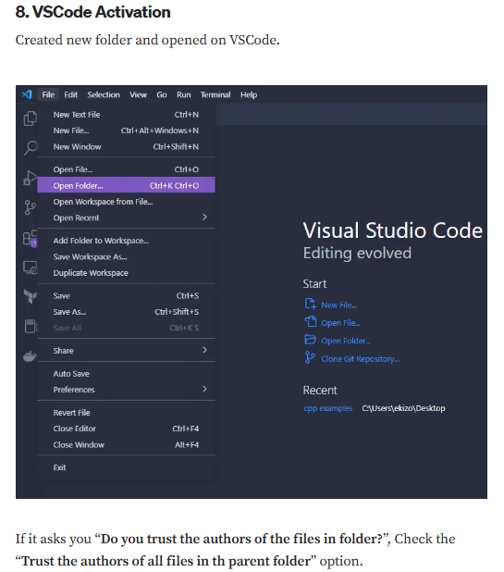
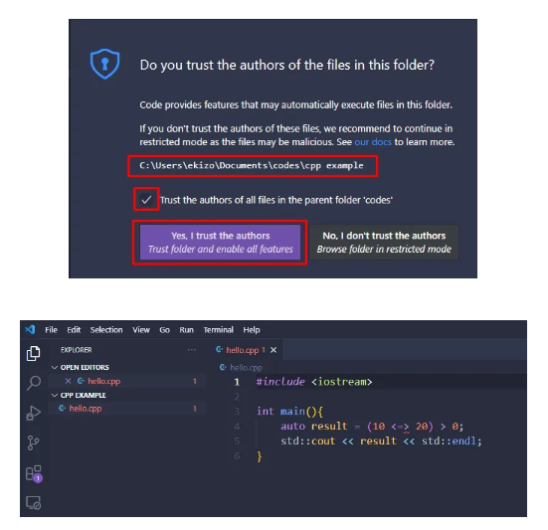
Introduction to C++ Programming Language
Setting up a Development Environment (VS Code)

Slide 16
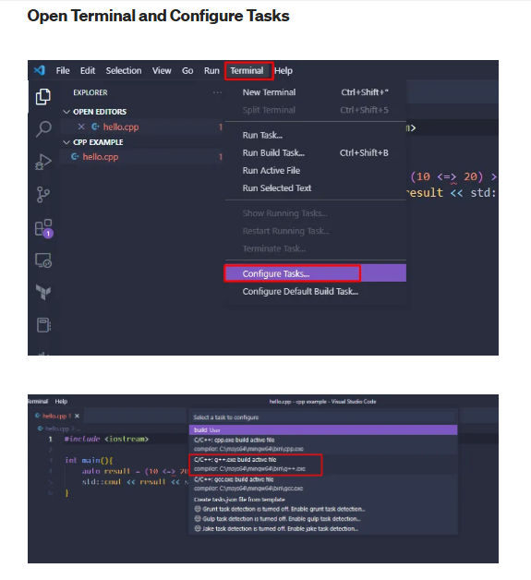
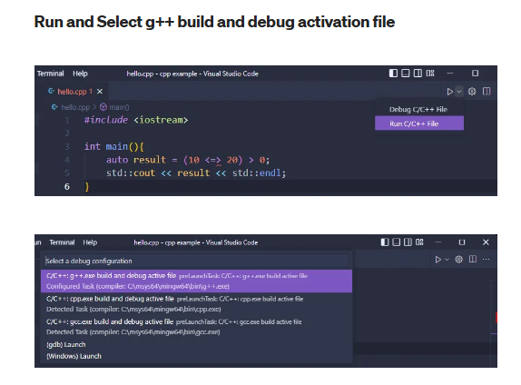
Introduction to C++ Programming Language
Setting up a Development Environment (VS Code)

Slide 17
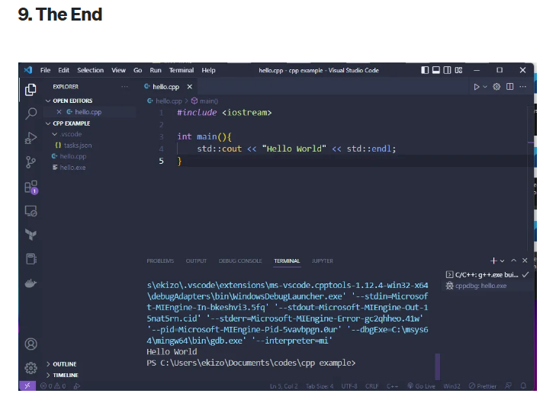
Introduction to C++ Programming Language
Setting up a Development Environment (VS Code)

Slide 18
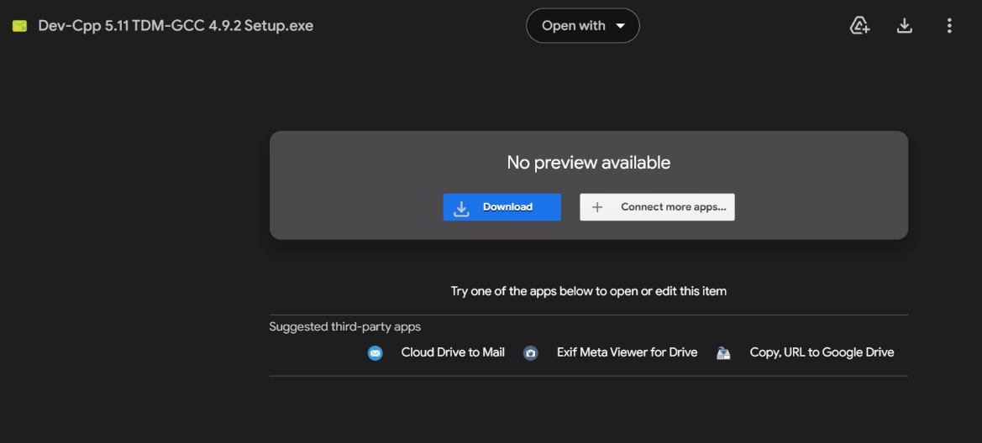
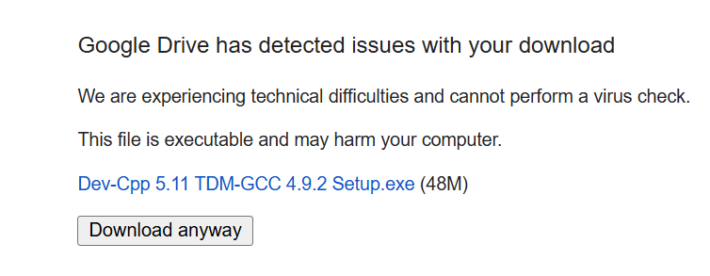
Introduction to C++ Programming Language
Setting up an Integrated Development Environment (Dev-C++)
Download Dev-C++ IDE
Download Dev-C++ by copiyng the link provide below and paste in your favorite browser.
Link: https://drive.google.com/file/d/1f8vLWnmboKLUTJCfiIUCPSt30QV0GEei/view?usp=drive_link

Slide 19
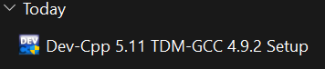
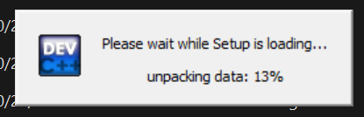
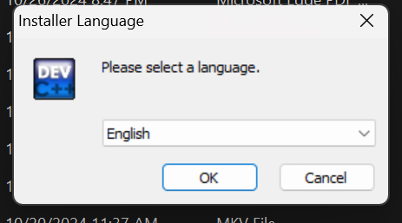
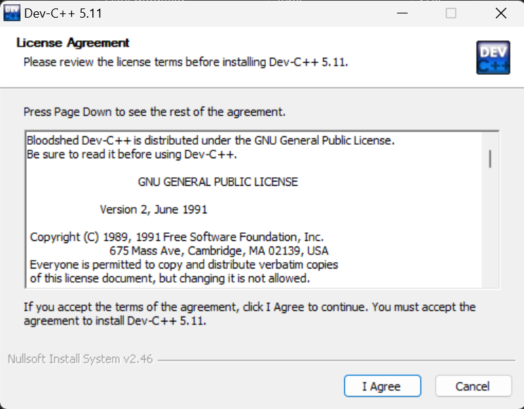
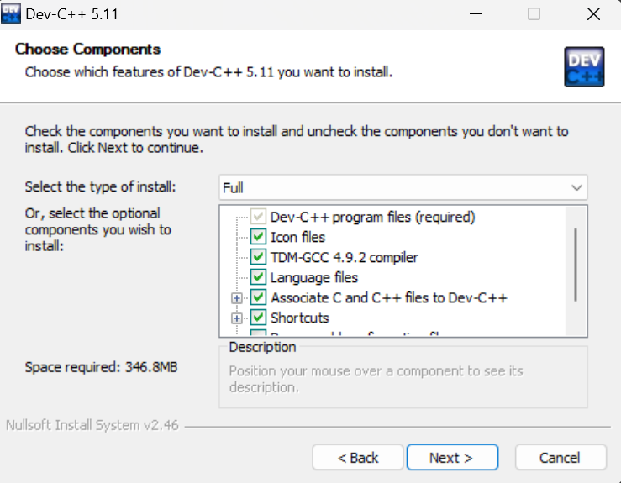
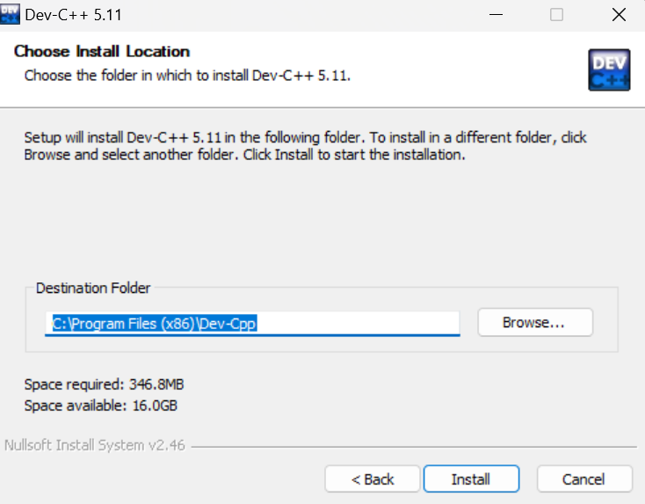
Introduction to C++ Programming Language
Setting up an Integrated Development Environment (Dev-C++)
Install Dev-C++ IDE
Open the folder where you have downloaded the IDE and double click to install it.
Press Enter to All

Slide 20
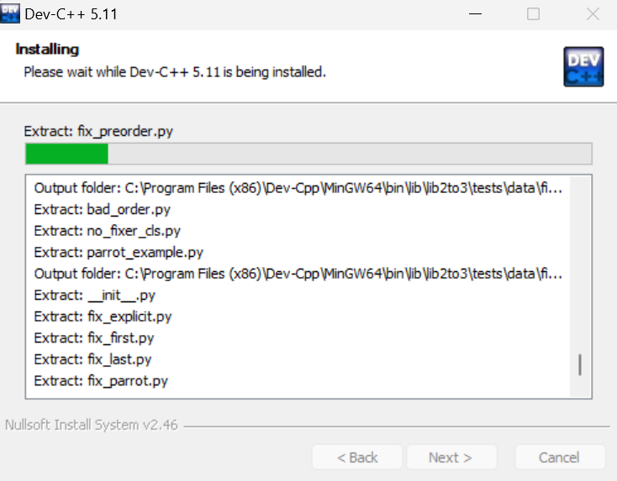
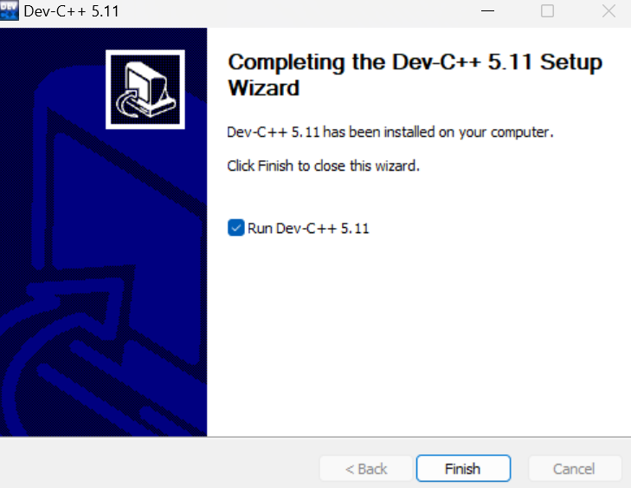
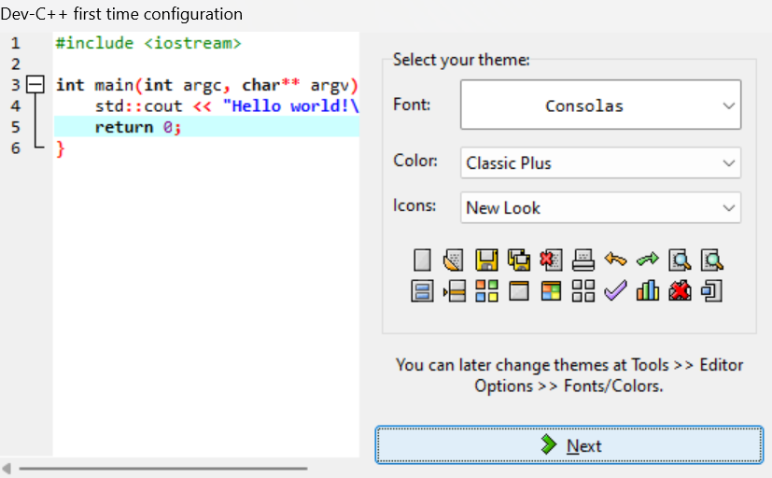
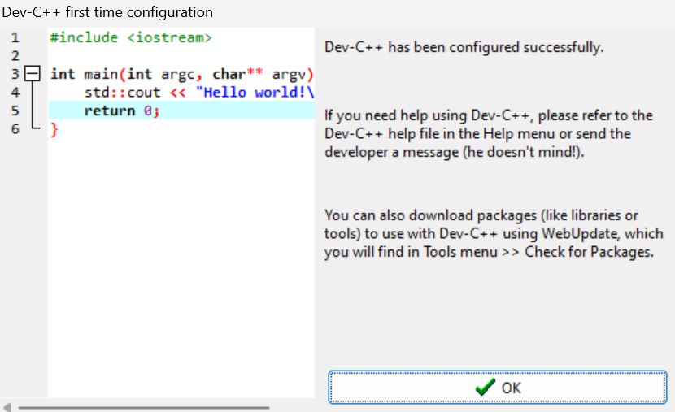
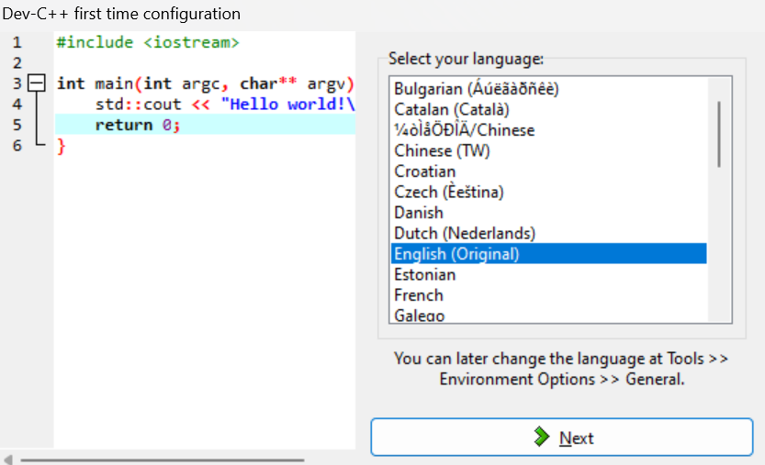
Introduction to C++ Programming Language
Setting up an Integrated Development Environment (Dev-C++)
Install Dev-C++ IDE
Open the folder where you have downloaded the IDE and double click to install it.
You installation has been started now.
Click Finished when Installed

Slide 21
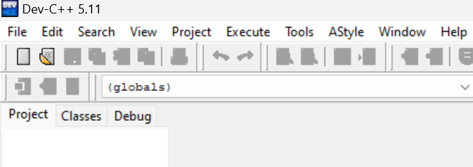
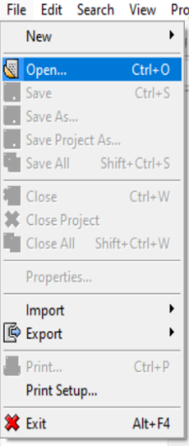
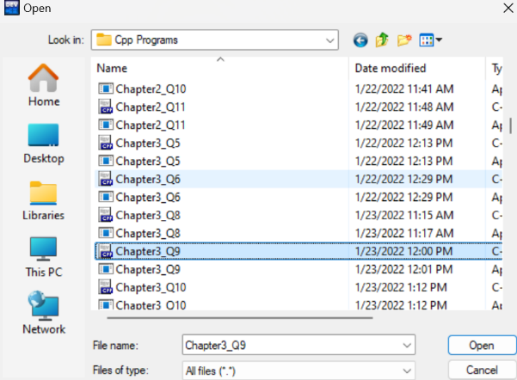
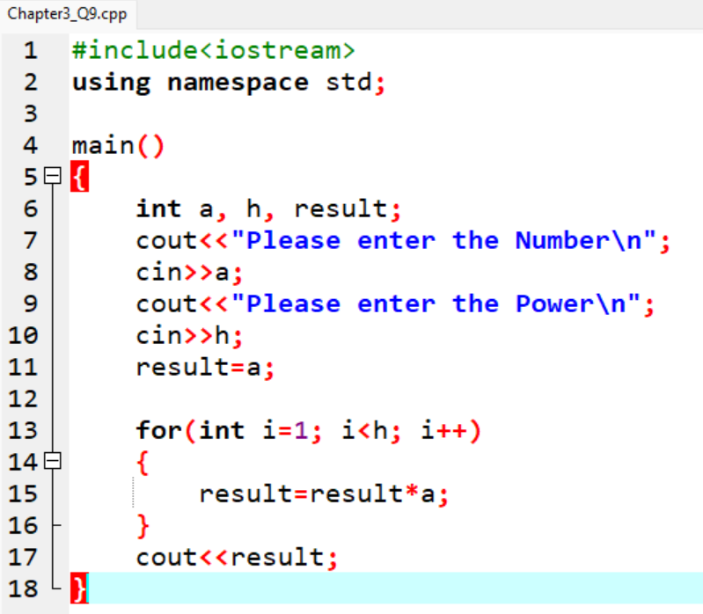
Introduction to C++ Programming Language
Setting up an Integrated Development Environment (Dev-C++)
Open an Existing Folder
If you have created a folder for your working you can open it by,
Click the file in the menu
Now click Open sub-menu
Go to the directory where you create the folder and open it.

Slide 22
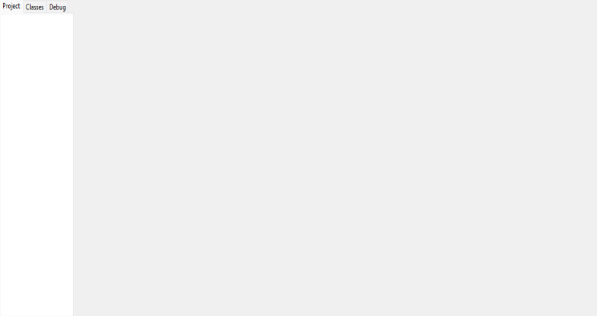
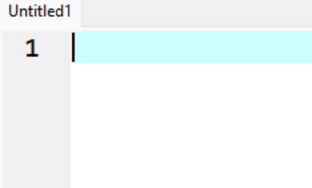
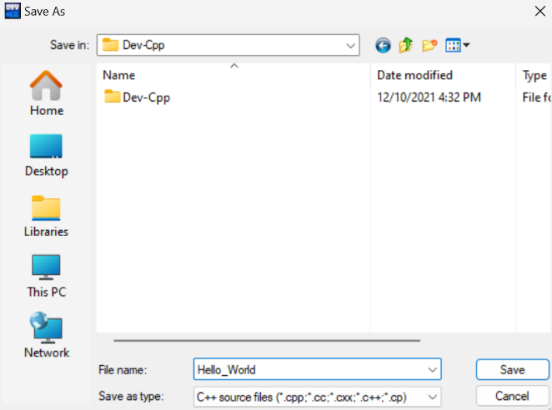

Introduction to C++ Programming Language
Setting up an Integrated Development Environment (Dev-C++)
Create New From Start
If you have not created any Folder yet you can start as
Open Dev-C++ application
Press Ctrl+N, it will create a new file with untitled name
Press Ctrl+S and save the file in you desire directory.
Now Compile the file and then Run it.
Empty Page
When press Ctrl+N
Run
When press Ctrl+S
Compile and Run
Compile

Slide 23

Introduction to C++ Programming Language
Setting up an Integrated Development Environment (Dev-C++)
Compile, Run and Output
If you want to run your file you have to compile it first as follows
Look at the menu for the icons seen on previous slide.
One is for compilation of the code
Second one is for running
And the third one is for both compilation and running.
When you compile and run the code, you can see your program output on the black screen which is .exe file of your code.

Slide 24

Basic Syntax and First Program
Hello, World Program
The "Hello, World!" program is a classic first program that displays "Hello, World!" on the screen. It helps introduce basic C++ syntax and structure.
Example Code

Slide 25
Basic Syntax and First Program
Explanation of Code Structure
#include <iostream>: Includes the iostream library, which contains functions for input and output.
using namespace std; : Allows the use of standard library functions without prefixing them with std:: (e.g., cout instead of std::cout)
int main() { ... } : Defines the main function, where the program starts execution.
cout << "Hello, World!" << endl; : Outputs "Hello, World!" to the screen.
cout is used for output.
<< is the stream insertion operator that sends data to the output.
endl adds a newline at the end of the output.
return 0; : Signals successful program completion to the operating system.

Slide 26

Basic Syntax and First Program
Running and Compiling a Program
Compile: Use the IDE's "Build" or "Compile" option to check for syntax errors and convert the code to machine language.
Run: After successful compilation, use "Run" to execute the program and see the output.
Run
hi
Output

Slide 27



Basic Syntax and First Program
Understanding Errors
Syntax Errors: Mistakes in code structure, like missing “ ; “ or mismatched brackets { }.
Runtime Errors: Errors that occur when the program is running, like dividing by zero.
Logical Errors: The program runs but does not produce the expected output due to incorrect logic.
Runtime Error
Syntax Error
Logical Error

Slide 28
Thank You

